Slide 1
SEMINAR PENGAJAR
(PLV & PPLV) ILJTM
TAHUN 2014
‘CABARAN DAN PROFESIONALISMA ILJTM’
TAJUK :
TRANSFORMASI JTM 2015 - 2025

Slide 11
TEVT TRANSFORMATION

Slide 12
MALAYSIA SKILLS TRAINING EVOLUTION
Overview
High Income & Advanced Economy
Year
'60
'70
'80
'90
'00
'10
‘20
Access & quality:
Skills Institutions
ILP & IKBN
(1964)
Community College
(2000)
GiatMARA
(1986)
IKM
(1968)
Polytechnics (1969)
Funding
Human Resources Development Act - HRDF (1992)
Act 640: The Skills Development Fund Act
(2004)
Human Resources Development Act - HRDF (1992)
Act 640: The Skills Development Fund Act
(2004)
Establishment of MLVK
(1989)
Education Act 550 – MOE
(1996)
Act 652: The National Skills Development Act (NASDA) (2006) – Establishment of DSD
Governance
NOSS introduction
(1992)
Act 556: National Accreditation Board Act (2007) – Establishment of MQA
Establishment of LAN
(1996)
Act 555: Private Higher Educational Institution Act (2007)

Slide 13
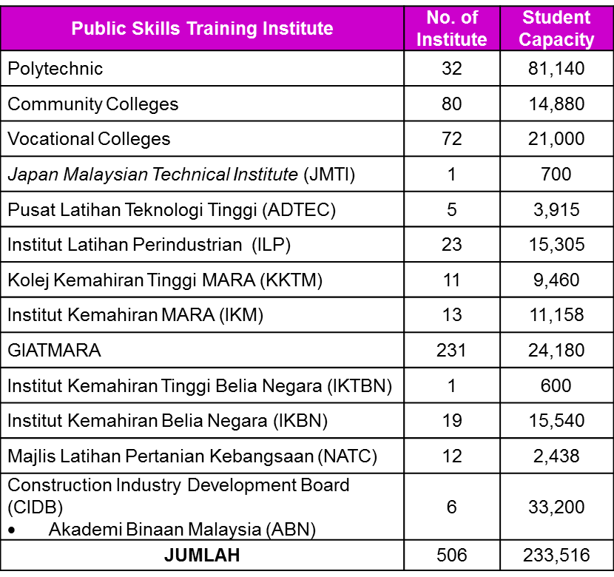
TEVT PROVIDERS
Overview
Establishment of skills training institute started as early in 1964 with introduction of IKBN Dusun Tua and ILP Kuala Lumpur
Currently more than 1,000 institutions offering Skills Training from federal ministries, State Skills Centre and private providers.
TEVT Delivery System
Qualifications
MOHR
MOYS
MRRD
MOE
MOA
KKR
MOD
States
BEng Tech
13
4
UniKL
IPTA
(MTUN)
Adv Dip
Tech
Polytechnics
1
32
DLKM +
Adv Dip Tech
JMTI
IKTBN
GMI
1
1
KKTM
DLKM
11
Dip Tech
DLKM + Diploma Technology
5
ADTEC
Private
Accredited
Centre
MOA Institutes
DKM
6
Sijil
Teknologi
IKM
13
ILP
23
72
Vocational Colleges
SKM 1,2,3 +
Sijil
Teknologi
19
12
IKBN
6
States institute
CIDB
(ABN)
1
Perhebat
Institutes
500
231
80
Private
Accredited
Centre
Giat
MARA
Community
College
SKM 1 & 2
Excludes state institutes
Public Skills Training Institues (Polytechnics, Community Colleges, ILP, JMTI,ADTEC, IKM/KKTM, GIATMARA, IKTBN/IKBN and NATC.
PTPK students loans for 2014: RM330 Mn (10th MP for 2011-2014: RM1.45 Bn)
13
Notes:
Tan Sri Chairperson and Members of meeting,
This slide share an overview of TEVT Providers while focusing on Public Skills Training Institution
Currently, there are more than 1,000 institutions offering TEVT education, of which 51% are Public Skills Training Centre, with 212,000 student enroll in 2013.
Overall, there are 506 Public Skills Training Institutions under 7 Federal Ministries offering TEVT educations with different curricular and standards offering about 356 program at different level and from various field of study. For Example : Electrical & electronic, Manufacturing, Construction, Automotive, Agriculture, Oil and Gas, Textile, Hospitality, ICT, Culinary, Civil Engineering, Welding and Metal Fabrication, Aviation and etc.
There are 2 agency accreditate and regulate TEVT Sectors namely, Malaysian Qualification Agency (MQA) and Department of Skills Development (DSD)
Government allocated at least RM2.1 Billion to operate all this Institutions

Slide 14
SUPPLY AND DEMAND FOR TEVT
Overview
Our national economic growth demands an increasingly higher number of TEVT graduates going forward
Economic growth demands additional ~1.3Mn quality TEVT workers
High level estimate of increased capacity of TEVT institutes required
Workers by 2020( in '000)
Required graduates by 2020 (in '000)
260,000 additional graduates
or ~26K additional capacity per year³
500
449
Highest demand expected in Tourism, Retail and Greater KL
1600
750
400
250
500
300
500
450
209
203
50
200
1100
400
140
260
132
170
30
100
101
230
30
53
46
43
27
23
20
20
Total to be delivered by TEVT system¹
Current graduates at Public institutes
Current graduates at Private institutes
Optimization & planned expansion in Public²
Remaining supply-demand gap
0
Tourism
Retail
Greater KL dev
Health care
Edu
Business Svcs
Fin. Svcs
EE
OGE
Agri
Palm Oil
CCI
NKEA sectors
Diploma
Certificate
Vocational Colleges, MOE will provide additional 25k-30k TEVT seats yearly
Assumptions:
1.Total to be delivered by TEVT system: graduates required for NKEA (1,330), with 15 to 20% moving to further education + graduates to be delivered for non NKEA sectors based on 2010 data (350,000) and excluding 350,000 diplomas to be produced by universities (public, private and KTAR. – source MOHE). 2. Optimization: additional capacity and redeployment to diplomas at Polytechnics (target: 356,000 diplomas by 2020), planned new institutes at MOHR and MOYS and hypothesis of potential optimization of utilization rate to 100% vs. 80-90% on average today (excl. Polytechnics). .3 Total graduates per year: 25 to 30K, or 50K capacity seats based on average of 2 enrolment years per graduate.
Source: Data request from TEVT agencies, Tracer Studies at MOHR, MOYS and Polytechnics, NKEA forecasts, BCG analysis

Slide 15
SUPPLY AND DEMAND FOR TEVT
Overview
Coordination needed to address gaps/ oversupply across NKEA sectors
Projected¹ TEVT graduates from public and private institutions against NKEA labor demand by 2020
Persons in '000
Projected oversupply of TEVT graduates in EE and CCI by 2020
500
449
400
300
209
203
205
200
129
132
101
100
80
53
82
30
46
30
43
27
23
20
20
2020 TEVT demand
1
16
2
3
5
5
2020 TEVT supply
0
Tourism
Retail
Greater KL dev
Health care
Edu
Business Svcs
Fin. Svcs
EE
OGE
Agri
Palm Oil
CCI
Need for auditing of existing TEVT program/courses to align and meet the needs of economic transformation
1. Projection of labor supply assumes a workforce growth of 2% per year, based on population growth rate
Source: MOHR; MOYS; MOHE; MOA; MORRD; PEMANDU

Slide 16
ILLUSTRATION: RAISING INCOME THROUGH SKILLS STRAINING
RATIONALIZATION OF PROGRAM/COURSES UNDER PUBLIC SKILLS TRAINING INSTITUTE THROUGH BOS
IMPLEMENTATION PROCESS
1
2
Physical auditing on courses based on NKEA sector( E&E, Tourism, Retail, Healthcare and Education
Auditing by MQA, JPK and 3rd Party to all Public Skills Training Institute
3
Presentation result of auditing
Quality TEVT graduates to meet industry demand
Recommendation for optimization of Institution
TEVT Central Coordinating Committee (EPU, DSD and MQA and all Public Skills Training Institute)
Develop a standard audit template with BOS principle
Template
Auditing
NBOS
ELIMINATE Sunset programmes and low performance institutions Construction of new training facilities and building | RAISE Training programmes with close industry collaboration or guaranteed job placement . Enhance buying places concept to Private Training Institutions for high demand programme/courses including crash programme.
REDUCE Duplicated/similar training courses for the same target group by various agencies | CREATE New programme to address demand gap (Tourism, retail, etc) Mobilise Instructor from private sector/institution to teach at Public Skills Training Centre.
BOS
Approach
Low cost to the government
High impact for the rakyat
Notes:
Honourable Dato’ Sri,
Under Skills Training, currently we have more than 1000 Skills Training Institute of which 51% are Public Skills Training Institute, under 6 Ministries, offering variety of programs, from Certificate level up to Advanced Diploma. As for 2014, about RM2.1 Billion under OE has been allocated to run these Institutions.
Under this Skills Training initiative of NBOS, all 506 Public Skills Training Institute will be audited to rationalised their course offering.
This audit exercise is a joint effort between EPU and Malaysian Qualifications Agency (MQA) under MOE and Department of Skills Development (DSD) under MOHR.
Implementation process for auditing exercise will involve three main tasks;
Developing the standard audit template using NBOS approach; i.e. Eliminate, Raise, Reduce and Create.
Physical auditing exercise will be carried out on 506 Institutes by MQA and DSD with the assistance of 3rd party. EPU is suggesting the appointment of consultants to ensure the independency and reliability of the auditing.
Audit report will be presented by industry sector, such as E&E, Tourism, Retail, Healthcare and Education (Early Childhood) based on NKEA sector.
By having this initiatives, we hope that the Skills Training programmes will meet the industry demand and requirements in providing quality human capital to support our economic transformation.

Slide 17
11th MALAYSIA PLAN

Slide 18
Expected Outcomes: TEVT under 11th Malaysia Plan (11th MP)
Institutions
Specialization and optimization
Programme
Industry compliance and high employability
Instructor / Lecturers
Highly skilled and better delivery
Public (Students)
Clear educations pathways and employment with better income
Industry
Better engagement with Institutions

Slide 19
Governance
WAY FORWARD TEVT: 11th MP STRATEGY PAPER
STRATEGY 1:
FORTIFYING GOVERNANCE OF TEVT SECTOR
Target | Agency | Issues/Gap /10th MP | 11th MP Action Plan | KPI (2016 – 2020) | Outcome
Establish Single TEVT Governance | EPU MQA DSD | No Institutions responsible for developing comprehensive TEVT strategic plan | Establish a single & independent (neutral) QA body (JPK & MQA under one umbrella) Merge the “skills sector ” and “vocational & technical sector ” into a single sector known as “TEVT sector” | One (1) single & independent (neutral) QA body “Skills sector” and “vocational & technical sector” merged as a TEVT sector | Effective TEVT delivery meeting industry demands
i

Slide 20
NEW MQF
Framework
TEVT
Higher education
L8
Doctoral degree
L7
Masters degree
Postgraduate dip.
L6
Bachelor degree
Bachelor degree
Graduate certificate
L5
Advanced Diploma
Advanced diploma
L4
Diploma
Diploma
L3
Certificate Level 3
Certificate
L2
Certificate Level 2
Accreditation
L1
Certificate Level 1
Single & Independent QA Body
Public Skills Training
Institutes
Kolej Vokasional
Majlis Latihan
Pertanian Kebangsaan

Slide 21
Governance
WAY FORWARD TEVT: 11th MP STRATEGY PAPER
STRATEGY 1:
FORTIFYING GOVERNANCE OF TEVT SECTOR
Target | Agency | Issues/Gap /10th MP | 11th MP Action Plan | KPI (2016 – 2020) | Outcome
Clear articulations and pathways for TEVT | MQA DSD | Malaysian Qualification Framework (MQF) consist of 3 track, skills, TEVT and academic. Fragmented articulations Unclear career path | Develop new TEVT Pathways Develop new TEVT delivery model to effectively manage articulations and career path. How? Shift the current operating model of “Agency-Centred-Self-Managed” model to “Cluster-Centred-Industry-Led TEVT” model. | New TEVT Pathways Numbers of Industry Skills Councils (ISCs) | Effective TEVT delivery meeting industry demands
ii

Slide 22
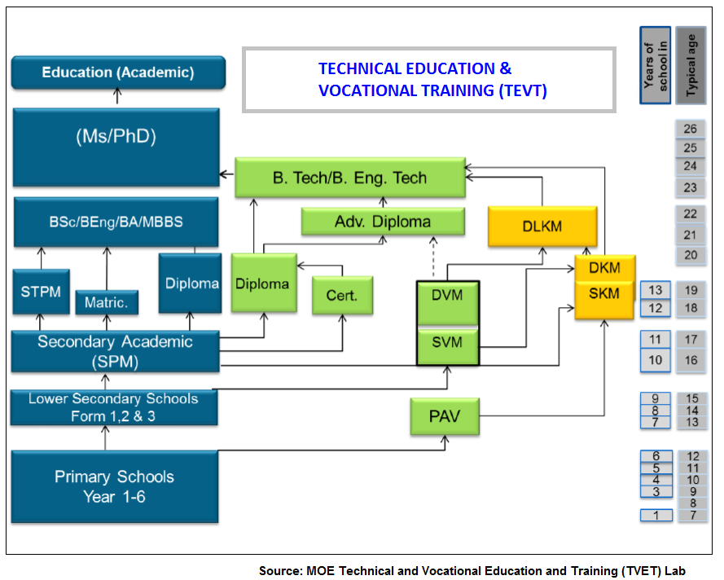
TEVT PATHWAYS

Slide 23
CLUSTERS UNDER TEVT SECTOR
Automotive
Biotechnology
Textiles & Apparel
Agriculture
Plastic
Building &
Construction
Telecomunication &
Multimedia
???
???
???
…………………
???

Slide 24
Example: Building & Construction Cluster
Industry Skills Council (ISC)
CIDB
KPI:
Clear Articulation & Pathway
Reduce overlapping of similar program offerings at the same levels
Adopt Occupational Standards (Ocs) developed by ISC
MQF
L8
L7
MTUNs
Articulation & career path
L6
L5
PUBLIC
L4
L3
PRIVATE
L2
L1
SDC

Slide 25
Governance
WAY FORWARD TEVT: 11th MP STRATEGY PAPER
STRATEGY 1:
FORTIFYING GOVERNANCE OF TEVT SECTOR
Target | Agency | Issues/Gap /10th MP | 11th MP Action Plan | KPI (2016 – 2020) | Outcome
Increased placements of TEVT student to Higher Education Institutions (HEI) | MQA MTUN | Limited number of TEVT students enroll in MTUN due to no designated quota. | Increase MTUNs’ quota for L4 & L5 TEVT graduates from 40% to 80% by 2020 Current capacity for TEVT Graduates: 40% x 4 MTUNs x 3000 capacity = 4,800 students. Proposed capacity: 80% x 4 MTUNs x 3000 capacity = 9,600 students. | 80% of MTUNs’ quota for TEVT graduates by 2020 Projected KV graduates to further studies at higher levels: 2016 - 900 2017 - 4,500 2018 - 6,300 2019 - 9,000 2020 - 10,800 ------------------- Total = 31,500 | Effective TEVT delivery meeting industry demands
iii

Slide 26
Profession Acknowledgement
WAY FORWARD TEVT: 11th MP STRATEGY PAPER
STRATEGY 2:
RECOGNITION FOR TECHNOLOGIST
Target | Agency | Issues/Gap /10th MP | 11th MP Action Plan | KPI (2016 – 2020) | Outcome
MBOT establishment for recognition of TEVT graduates career pathways | MBOT MQA DSD | Technologist not recognise as professional under Board of Engineers Malaysia (BEM) | Executing MBOT Act and technologist profession establishment (Subject to the approval of MBOT Act) | Engineering Technologist recognised as professional (under MBOT) on par with Engineer (under BEM) | Recognition of TEVT graduates
i

Slide 27
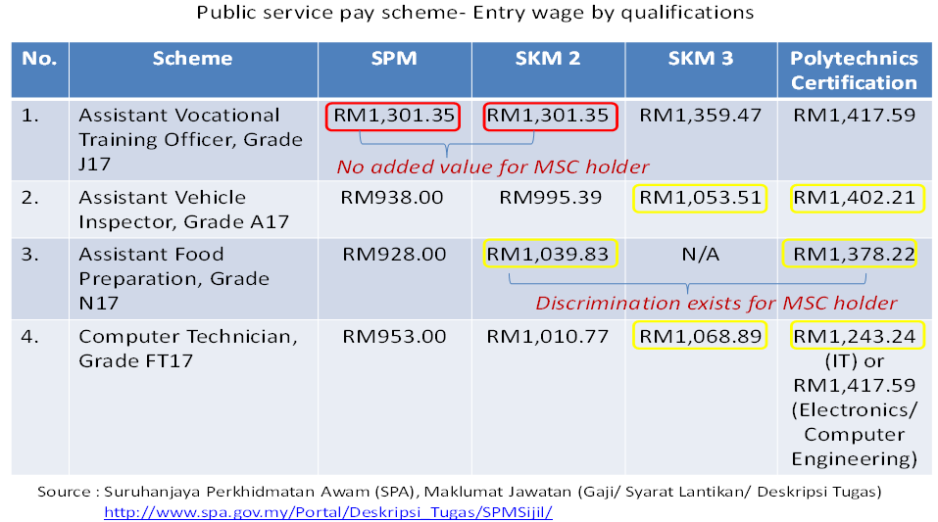
Wage Discrimination
for SKM holders in the public service

Slide 28
Profession Acknowledgement
WAY FORWARD TEVT: 11th MP STRATEGY PAPER
STRATEGY 2:
RECOGNITION FOR TECHNOLOGIST
Target | Agency | Issues/Gap /10th MP | 11th MP Action Plan | KPI (2016 – 2020) | Outcome
Wage recognition for TEVT Graduates | DSD | In the Public: Wage discrimination in the Public Service In the Private: Lack of reference for employers to set up wages for TEVT graduates Lack of recognition for TEVT graduates by employers | In the Public: Under the same service scheme, give the same starting pay for any TEVT qualifications if they are at the same MQF Level. In the Private: ISCs to propose wage structure for TEVT qualifications to be used as a reference by in their sectors. | % of the related schemes revised for the starting pay. % of qualifications with wage structure proposed. Number of companies adopted the wage structure | Recognition of TEVT graduates
ii

Slide 29
JTM WAY FORWARD
Kursus
Penjumudan kursus
Penggabungan kursus (Rebranding)
COSE (Expansion)
Kecilkan / Kurangkan Penawaran
Upgrade (Professional Recognition)
KV
Single System / Certification
Pengajar
Reskilling / Multiskilling
Perjawatan Kejat

